Slide 1

OSU Center for Health Sciences Security and Safety Training for Employees

Slide 2

Chief of Security
Meagan Robertson
918-625-8592 meagan.robertson@okstate.edu chs.security@okstate.edu
CHS Campus
Safety Manager
Patty White
918-561-8391
patty.white@okstate.edu
Huston Center 5th floor
Employee Nurse
Jennifer Nachbor
918-582-1980
jennifer.nachbor@okstate.edu
Health Care Center
Director of Human Resources/Title IX Coordinator
Tina Tappana
918-594-8105
tina.tappana@okstate.edu
OSU-Center for Health Sciences and OSU Tulsa

Slide 3
Security Officers
                9 TOTAL
  Officer Dennis Grill dennis.grill@okstate.edu 918-625-8592
  Officer Kurtis Geiger kurtis.Geiger@okstate.edu 918-625-8592
  Officer Tyler Austin anthony.austin@okstate.edu 918-625-8592
  Officer Mike Kunze michael.kunze@okstate.edu 918-625-8592
  Officer Kari Blackheart kari.blackheart@okstate.edu 918-625-8592
  Officer Corey Chance corey.chance@okstate.edu 918-625-8592
  Officer David Reynolds davreyn@okstate.edu 918-625-8592
  Officer Lucas Hunsucker lucas.Hunsucker@okstate.edu 918-625-8592

Slide 4
Security Department
1111 W. 17th Street Tulsa, Ok 74107
First Floor in CAME Building
Security Department is operation 24/7 all year.
  Including all Holidays
ALL EMERGENCY SITUATIONS CALL SECURITY AT
918-625-8592
Security’s email is chs.security@okstate.edu

Slide 5
Security Requirements
ID Badges
  MUST be worn and visible while in CHS Buildings
    Badges are free
    Badges do expire every year as a Security procedure
    Lost or Stolen report immediately
Parking Permits
  MUST be on employees vehicle while on CHS Property
    Permits are free
    Permits need to be placed under rearview mirror
    DO NOT park in spaces that say RESERVED

Slide 6
Cont. Vehicles
Vehicles left in parking lots overnight
  MUST have parking permits
  Owner should notify Security
    Location, Description, Duration
  Patient who have been transported to hospital
    Notify Security so it does not get towed
      Location, Description, Duration

Slide 7
Security Services
Security assists with car jumps
  All vehicles on OSU-CHS property
    MUST SIGN LIABILITY WAVIER
Security assists with tire Changes
  All vehicles on OSU-CHS property
    MUST SIGN LIABILITY WAVIER
Security safety escorts are available 24 hours a day
  TO and FROM Buildings
Security will wait until tow truck arrives
Security Maintains lost and found
  Items are logged into a tracking system
  Photographed
  Property must be signed out upon return

Slide 8
Panic Alarms or Emergency Calls
Know where the panic alarms are
Try to call Security 918-625-8592
  In case the alarm failed
Stay on the phone
  Describe what is happening, who, what and where

Slide 9
Suspicious Activity
Call immediately
DO NOT WAIT!
MENTALLY ILL
  Suicidal Intentions (SI)
  Community Outreach Psychiatric Emergency Services COPES
    Crisis Line 918-744-4800

Slide 10
Cont. Suspicious Activity
Abandon Bags
  DO NOT OPEN
  Call Security

Slide 11
Court Orders/Protective Orders
Security needs to be notified
  Copies
  All Details that may help
Safety Place

Slide 12
Title IX Issues
When and How to Report
Any Harassment
  Tina Tappana
  Director of Human Resources
  Title IX Coordinator
  Oklahoma State University Center for Health Sciences and OSU Tulsa
  Tina.Tappana@okstate.edu
  918-594-8105

Slide 13
Security Alerts
Cowboy Alert
  Sign up through Okey account
Via Text, Email and Phone call
Rave Guardian App. for Cell phone
  Free
  Mobile panic button
https://health.okstate.edu/about/security/cowboy-guardian/html
  Mobile panic alarm

Slide 14

We always need to err on the side of caution.
Being Inconvenienced is a small price to pay if Safety!!

Slide 15
Emergency Planning
Each Department should have a clear plan in place.
Each Department should have a backup plan.
  Employees must be educated about the plan.
  Employees must training the plan.
    Train how you fight
      Drills
  Accountability

Slide 16
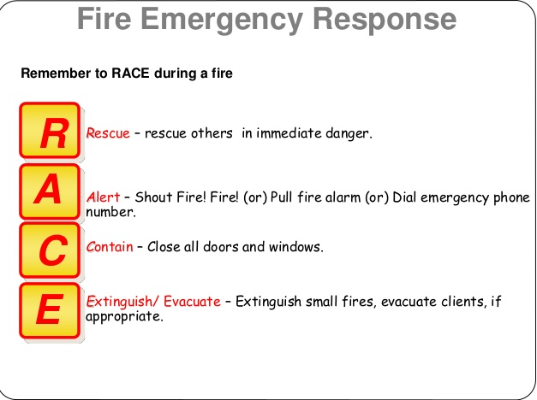
Fire Evacuation

Slide 17
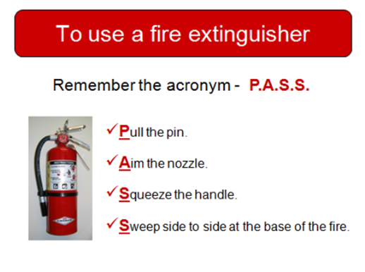

Slide 18
Fire
Designated area to meet
Head Count
Do not jump into the your car and leave
We need to be accountable for everyone
  Security are not Fire Fights they cannot enter the building to pull you out.
  Leave belongings
  Do not re-enter the building

Slide 19
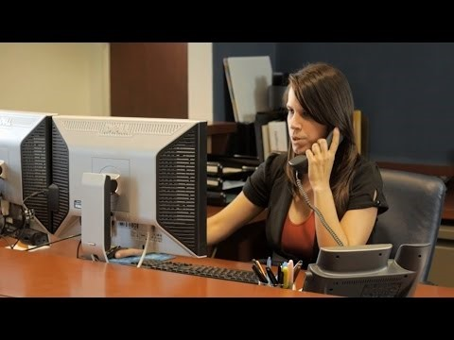
Bomb Threats
Checklist at each phone
Make sure to follow the list as much as possible.

Slide 20
Severe Weather
Storm Ready Campus
  Officers are monitoring weather in dispatch office
10 mile perimeter around Main CHS Campus
Cowboy alert sends out warning via National Weather Service
Know where to seek shelter

Slide 21
ACTIVE SHOOTER TIPS
SITUATIONAL AWARENESS
Situational awareness involves being aware of your immediate surroundings and the impact of your or other’s actions as it relates to the well-being of yourself and those around you.
Plan Plan Plan

Slide 22

3 STEPS TO FOLLOW

Slide 23
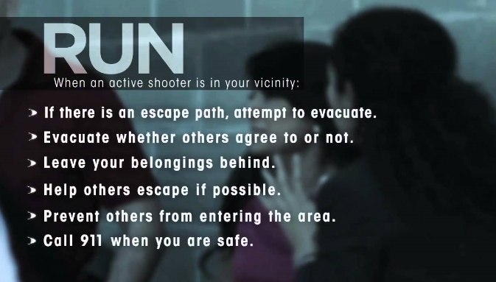
EVACUATE (IF POSSIBLE)

Slide 24
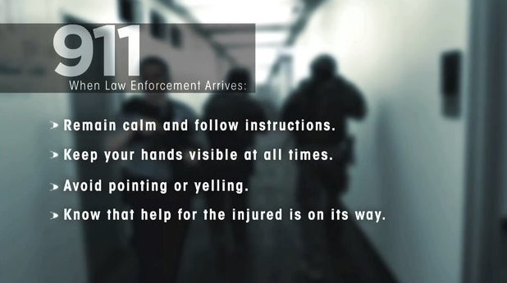
ONCE YOU HAVE ESCAPED

Slide 25
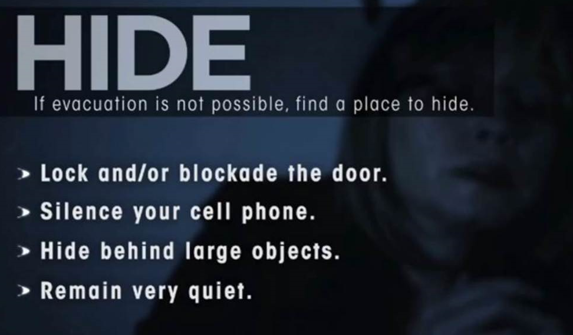
LOOK FOR WAYS/OBJECTS TO HELP BARRICADE DOORS

Slide 26
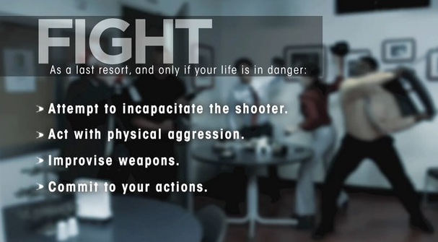
LAST RESORT

Slide 27
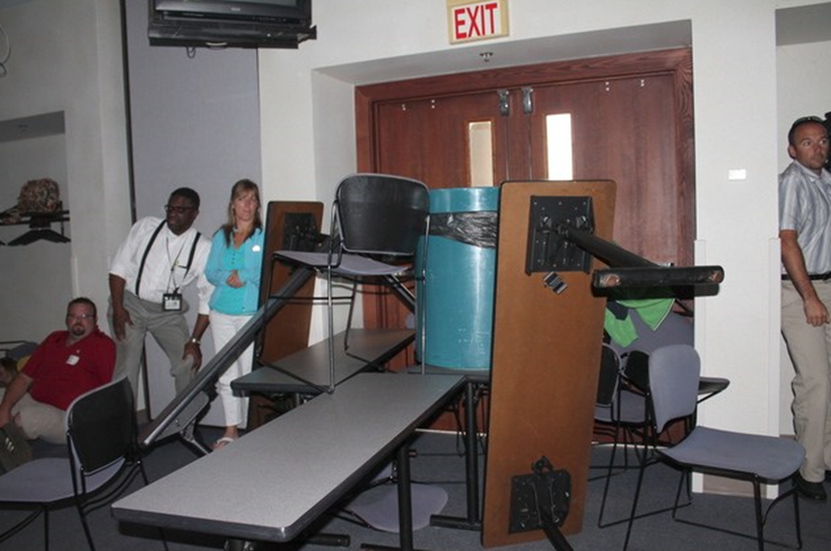
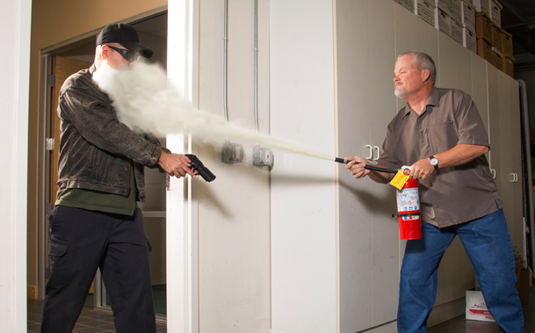
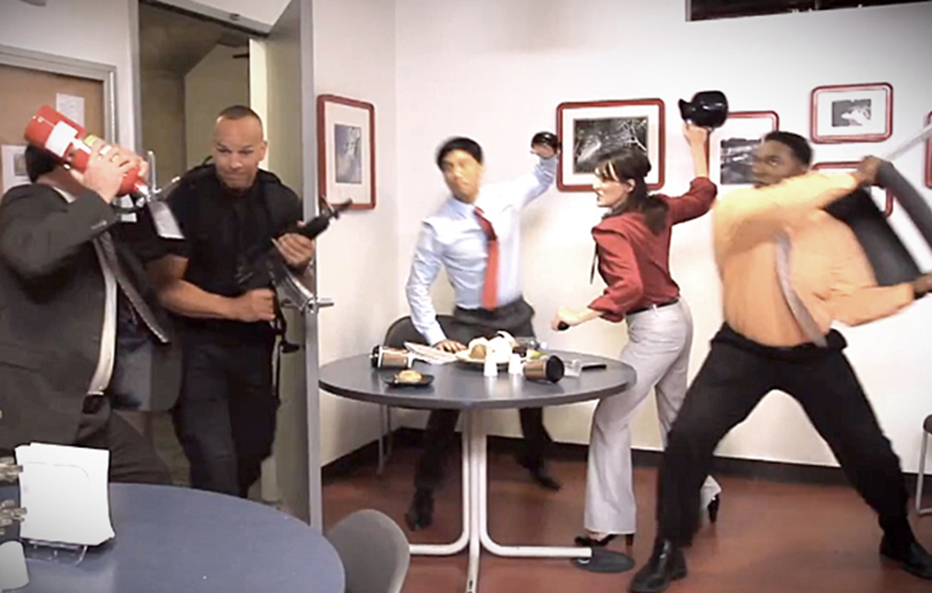

Slide 28
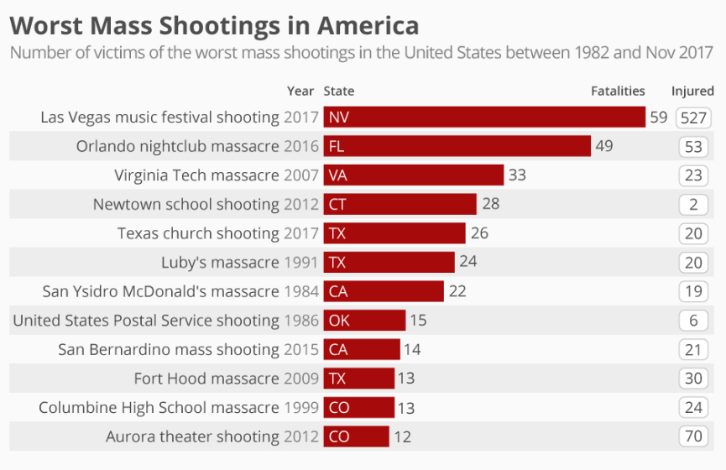

Slide 29
REPORT INJURIES
Notify Security
Security will create a report that is submitted to Safety to investigate

Slide 30
Other Resources
Security website https://.okstate.edu/about/security/index.html
Has Clery Information

Slide 31
Conveying CHS-Security’s Mission Statement
To provide a safe and secure work place
Establishing a relationship between Security, Safety and Employees
Security’s ultimate goal is to serve and protect individuals while on campus

Slide 32
QUESTIONS

