Slide 1
OSU Center for Health Sciences Security and Safety Training for Employees

Slide 2
Chief of Security Meagan Robertson 918-625-8592 meagan.robertson@okstate.edu chs.security@okstate.edu CHS Campus
Safety Manager
Patty White
918-561-8391
patty.white@okstate.edu
Huston Center 5th floor
Employee Nurse
Jennifer Nachbor
918-582-1980
jennifer.nachbor@okstate.edu
Health Care Center
Director of Human Resources/Title IX Coordinator
Tina Tappana
918-594-8105
tina.tappana@okstate.edu
OSU-Center for Health Sciences and OSU Tulsa

Slide 3
Security Officers
9 TOTAL
Officer Dennis Grill dennis.grill@okstate.edu 918-625-8592
Officer Kurtis Geiger kurtis.Geiger@okstate.edu 918-625-8592
Officer Tyler Austin anthony.austin@okstate.edu 918-625-8592
Officer Mike Kunze michael.kunze@okstate.edu 918-625-8592
Officer Kari Blackheart kari.blackheart@okstate.edu 918-625-8592
Officer Corey Chance corey.chance@okstate.edu 918-625-8592
Officer David Reynolds davreyn@okstate.edu 918-625-8592
Officer Lucas Hunsucker lucas.Hunsucker@okstate.edu 918-625-8592

Slide 4
Security Department 1111 W. 17th Street Tulsa, Ok 74107 First Floor in CAME Building
Security Department is operation 24/7 all year.
Including all Holidays
ALL EMERGENCY SITUATIONS CALL SECURITY AT
918-625-8592
Security’s email is chs.security@okstate.edu

Slide 5
Security Requirements
ID Badges
MUST be worn and visible while in CHS Buildings
Badges are free
Badges do expire every year as a Security procedure
Lost or Stolen report immediately
Parking Permits
MUST be on employees vehicle while on CHS Property
Permits are free
Permits need to be placed under rearview mirror
DO NOT park in spaces that say RESERVED

Slide 6
Cont. Vehicles
Vehicles left in parking lots overnight
MUST have parking permits
Owner should notify Security
Location, Description, Duration
Patient who have been transported to hospital
Notify Security so it does not get towed
Location, Description, Duration

Slide 7
Security Services
Security assists with car jumps
All vehicles on OSU-CHS property
MUST SIGN LIABILITY WAVIER
Security assists with tire Changes
All vehicles on OSU-CHS property
MUST SIGN LIABILITY WAVIER
Security safety escorts are available 24 hours a day
TO and FROM Buildings
Security will wait until tow truck arrives
Security Maintains lost and found
Items are logged into a tracking system
Photographed
Property must be signed out upon return

Slide 8
Panic Alarms or Emergency Calls
Know where the panic alarms are
Try to call Security 918-625-8592
In case the alarm failed
Stay on the phone
Describe what is happening, who, what and where

Slide 9
Suspicious Activity
Call immediately
DO NOT WAIT!
MENTALLY ILL
Suicidal Intentions (SI)
Community Outreach Psychiatric Emergency Services COPES
Crisis Line 918-744-4800

Slide 10
Cont. Suspicious Activity
Abandon Bags
DO NOT OPEN
Call Security

Slide 11
Court Orders/Protective Orders
Security needs to be notified
Copies
All Details that may help
Safety Place

Slide 12
Title IX Issues
When and How to Report
Any Harassment
Tina Tappana
Director of Human Resources
Title IX Coordinator
Oklahoma State University Center for Health Sciences and OSU Tulsa
Tina.Tappana@okstate.edu
918-594-8105

Slide 13
Security Alerts
Cowboy Alert
Sign up through Okey account
Via Text, Email and Phone call
Rave Guardian App. for Cell phone
Free
Mobile panic button
https://health.okstate.edu/about/security/cowboy-guardian/html
Mobile panic alarm

Slide 14
We always need to err on the side of caution.
Being Inconvenienced is a small price to pay if Safety!!

Slide 15
Emergency Planning
Each Department should have a clear plan in place.
Each Department should have a backup plan.
Employees must be educated about the plan.
Employees must training the plan.
Train how you fight
Drills
Accountability

Slide 16
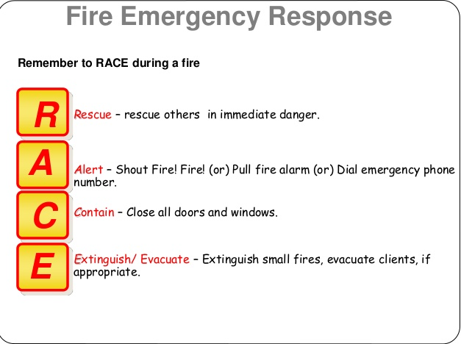
Fire Evacuation

Slide 18
Fire
Designated area to meet
Head Count
Do not jump into the your car and leave
We need to be accountable for everyone
Security are not Fire Fights they cannot enter the building to pull you out.
Leave belongings
Do not re-enter the building

Slide 19
Bomb Threats
Checklist at each phone
Make sure to follow the list as much as possible.

Slide 20
Severe Weather
Storm Ready Campus
Officers are monitoring weather in dispatch office
10 mile perimeter around Main CHS Campus
Cowboy alert sends out warning via National Weather Service
Know where to seek shelter

Slide 21
ACTIVE SHOOTER TIPS
SITUATIONAL AWARENESS
Situational awareness involves being aware of your immediate surroundings and the impact of your or other’s actions as it relates to the well-being of yourself and those around you.
Plan Plan Plan

Slide 22
3 STEPS TO FOLLOW

Slide 23
EVACUATE (IF POSSIBLE)

Slide 24
ONCE YOU HAVE ESCAPED

Slide 25
LOOK FOR WAYS/OBJECTS TO HELP BARRICADE DOORS

Slide 26
LAST RESORT

Slide 27
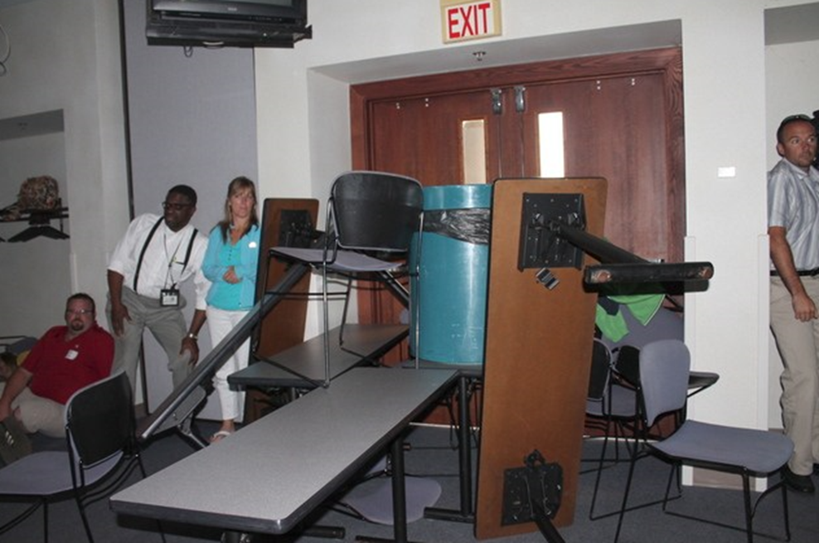
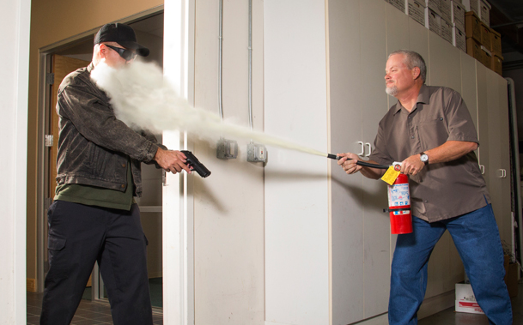
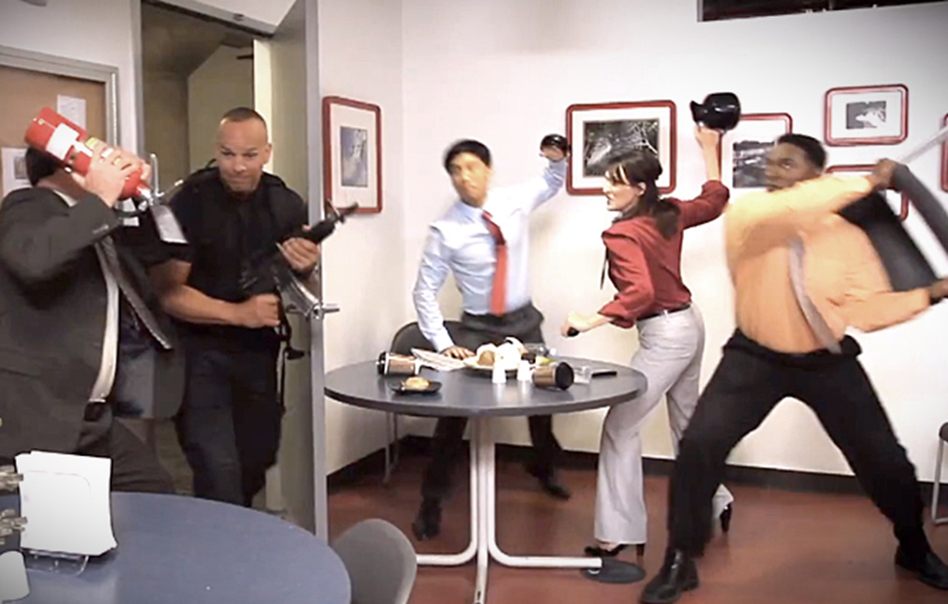

Slide 29
REPORT INJURIES
Notify Security
Security will create a report that is submitted to Safety to investigate

Slide 30
Other Resources
Security website https://.okstate.edu/about/security/index.html
Has Clery Information

Slide 31
Conveying CHS-Security’s Mission Statement
To provide a safe and secure work place
Establishing a relationship between Security, Safety and Employees
Security’s ultimate goal is to serve and protect individuals while on campus

Slide 32
QUESTIONS

