Slide 1
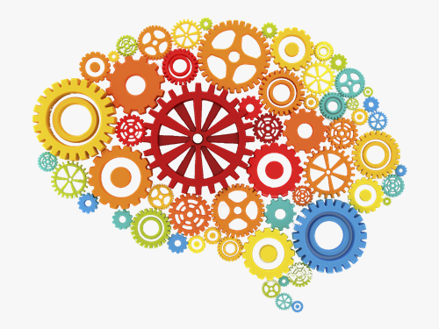
Unconscious bias It Matters
Presented by Training Evolution, Inc.

Slide 2
Your Objectives
Understand the definition of unconscious bias.
Understand the different types of unconscious bias.
Understand the sources of unconscious bias.
Understand the pros and cons of unconscious bias.
Understand ways to avoid unconscious bias in the workplace.

Slide 3
Unconscious Bias Defined
Unconscious bias are social stereotypes about certain groups of people that individuals form outside their unconscious awareness.
Unconscious bias happens outside of our control. It occurs automatically and is triggered by our brain making a quick judgment.

Slide 4
Examples of Unconscious Bias in the Workplace

Slide 5
Why Do We Have Unconscious Bias?
“the human mind takes in 11 million bits of information every minute. But is consciously aware of only 40.”
Timothy Wilson, Univ. of Virginia
And since your brain cannot process 11 million bits of information a minute, it takes mental shortcuts.

Slide 6
Mental Shortcuts Simulated
Aoccdrnig to rseearch at Cmabrigde
Uinervtisy, it deosn’t mttaer in waht
oredr the ltteers in a wrod are, the
olny iprmoetnt tihng is taht the frist
and lsat ltteer be at the rghit pclae,
The rset can be a toatl mses and you
can sitll raed it wouthit porbelm.
This is bcuseae the huamn mnid
deos not raed ervey lteter by istlef,
but the wrod as a wlohe.

Slide 7
Do You Have Unconscious Bias?
How much of what your see, hear, feel, experience, etc. are you aware of?
How much of what you do is under conscious control?
How accurate is your judgement of what you see, hear, feel, experience, etc.?
How fair minded are you?

Slide 8
Do You Have Unconscious Bias?
“A father and son were involved in a car accident in which the father was killed and the son was seriously injured. The father was pronounced dead at the scene of the accident and his body was taken to a local morgue. The son was taken by ambulance to a nearby hospital and was immediately wheeled into an emergency operating room. A surgeon was called. Upon arrival and seeing the patient, the attending surgeon exclaimed “Oh my God, it’s my son!’
Can you explain this?”

Slide 9
9 Types of Unconscious Bias

Slide 10
9 Types of Unconscious Bias, cont’d

Slide 11
9 Types of Unconscious Bias, cont’d

Slide 12
Unconscious Bias – The Pros & Cons

Slide 13
What’s Your Story?

Slide 14
Avoiding Unconscious Bias

Slide 15
Language to Assist in the Elimination of Bias
Use language that is clear and non-biased, such as "he or she" instead of always using "he" in internal documents, job descriptions and other management practices. (College applications.)
Also, managers often subconsciously use positive language for preferred team members or groups.
Lack of clarity can cause confusion and create openings for bias to emerge.

Slide 16
The Language of Inclusion
Don’t single out a person’s race, sex, ethnicity or personal characteristics when it is irrelevant to the topic.
Call people by their preferred names.
Avoid identifying people based on a disability.
Use gender-neutral language.
Avoid stories, photographs and captions that make assumptions based on stereotypes.
Avoid stories that emphasize exceptions to stereotypes.

Slide 17
Building Personal Awareness
Perceptions
Stereotyping
Polarization
Self-Fulfilling Prophecy

Slide 18
Growing in Awareness
Consistency Theory
Frames of Reference
Working from our perceptions, we formulate assumptions about people based on their belief systems or personality traits.
Our frame of reference is the way we interpret the world around us.
It is a habitual way of looking at things, based on our experiences, background, skills and attitudes.

Slide 19
Experiencing Labels
What did you notice about the interactions?
How did the labels impact the context of what was being said?
What impact did the labels have on behaviors?

Slide 20
Additional Activities

Slide 21
Plan to Act
How will you prevent unconscious bias?
How will you maximize this investment?
What are your goals for implementation?

